Slide 1
Brachial Plexus
Dr Anita Rani
24th October 2016

Slide 2
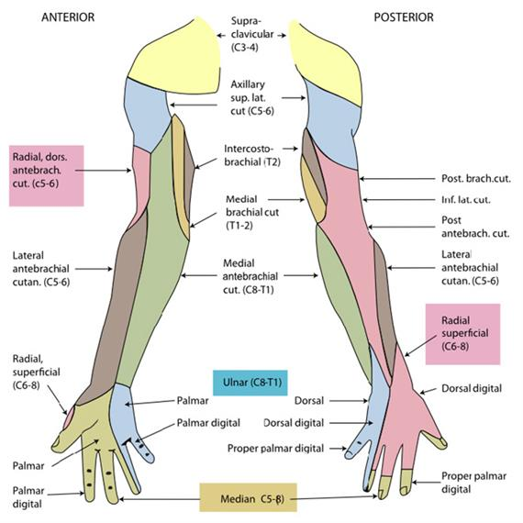
Nerve supplying upper limb
Supraclavicular branches of cervical plexusC4
Brachial Plexus C5-8, T1
Intercostobrachial branch of 2nd intercostal nerve
Sympathetic nerves

Slide 3
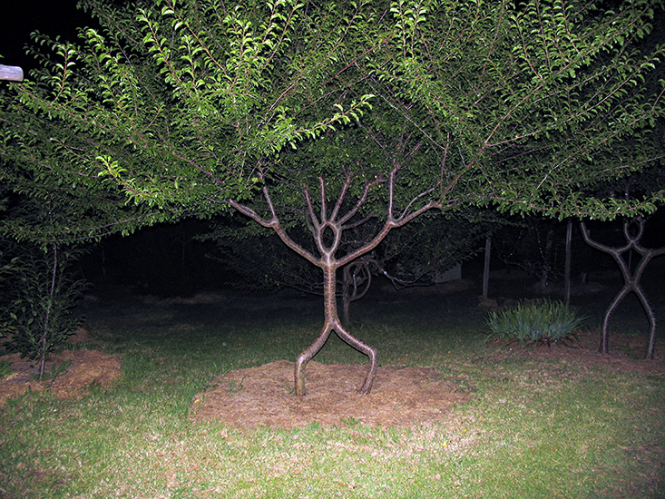
Brachial Plexus: 5Parts
Supraclavicular in neck
Roots
Trunks
Posterior to clavicle :Divisions
Infraclavicular:In axilla
Cords
Branches

Slide 5
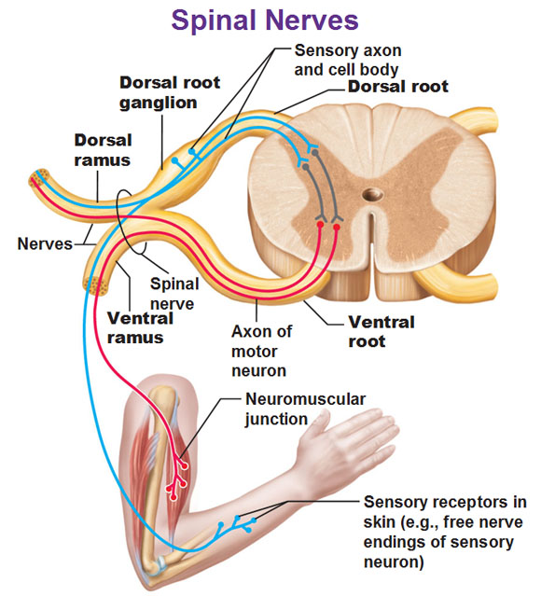
Brachial Plexus: ROOTS 5
ANTERIOR PRIMARY RAMI of C5,C6,C7,C8,T1

Slide 6
Brachial Plexus: ROOTS 5
Also , fibres are contributed by C4 and T2

Slide 7
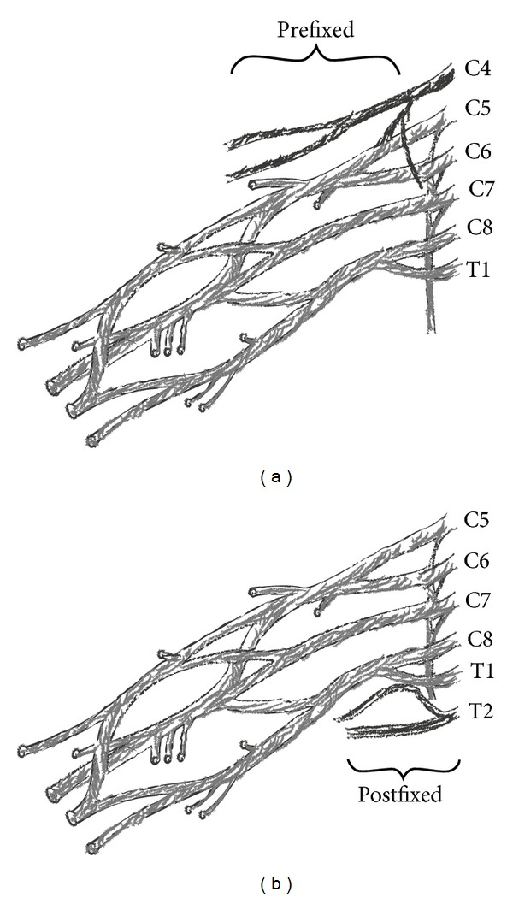
Brachial Plexus: ROOTS 5
Prefixed plexus large contribution from C4 but not from T2
Postfixed plexus: large contribution from T2 but not from C4

Slide 8
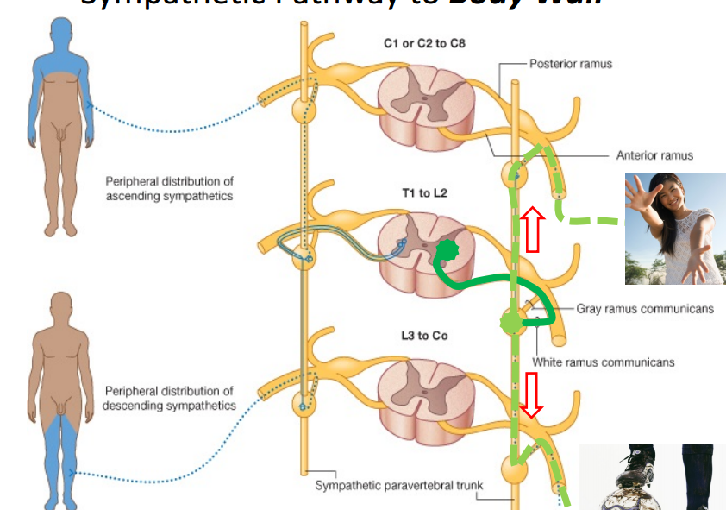
Sympathetic innervation of limb

Slide 9
Brachial Plexus: 3TRUNKS
C5 and C6: Upper Trunk
C7 : Middle Trunk
C8 and T1: Lower Trunk

Slide 10
Brachial Plexus: 2 DIVISIONS
Each trunk divides in to
Ventral division ..... to supply flexor aspect
Dorsal division......to supply extensor aspect

Slide 11
Brachial Plexus: 3CORDS
Divisions join to form cords
Ventral divisions of upper & middle trunks: Lateral cord
Ventral division of lower trunk: Medial cord
Dorsal divisions of all trunks: Posterior cord

Slide 12
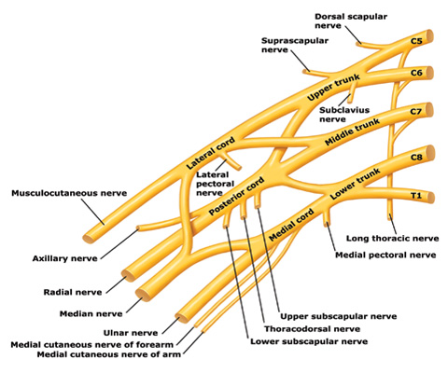
Brachial Plexus: BRANCHES from ROOTS
Nerve to serratus anterior or long thoracic nerve ( C5, C6, C7)
Nerve to Rhomboids or dorsal scapular nerve( C5)

Slide 13
Brachial Plexus: BRANCHES from TRUNK
ONLY FROM UPPER TRUNK
Suprascapular nerve( C5,6)
Nerve to subclavius ( C5,6)

Slide 14
Brachial Plexus: BRANCHES from Lateral cord
1. Lateral pectoral
( C5,6,7)
2. Musculo-cutaneous
( C5,6,7)
3. Lateral root of Median ( C5,6,7)

Slide 15
Brachial Plexus: BRANCHES from Medial Cord
Medial pectoral ( C8, T1)
Medial cutaneous nerve of arm (C8, T1)
Medial cutaneous nerve of forearm ( C8, T1)
Medial root of median nerve( C8, T1)
Ulnar Nerve( C7,8, T1)

Slide 16
Brachial Plexus: BRANCHES from PosteriorCord
Upper subscapular (C5,6)
Nerve to Latissimus dorsi or Thoracodorsal nerve ( C6,7,8)
Lower subscapular (C5,6)
Axillary nerve ( C5,6)
Radial nerve ( C5,6,7,8, T1)

Slide 17
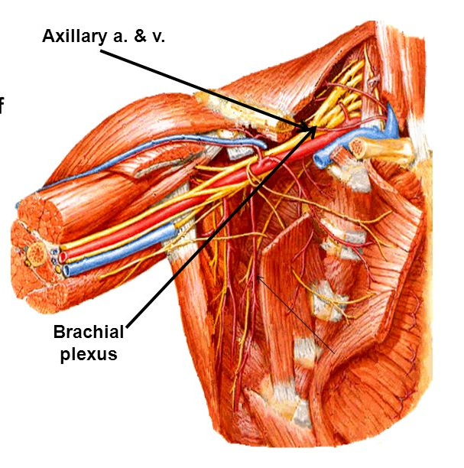
Brachial plexus and axillary artery

Slide 18
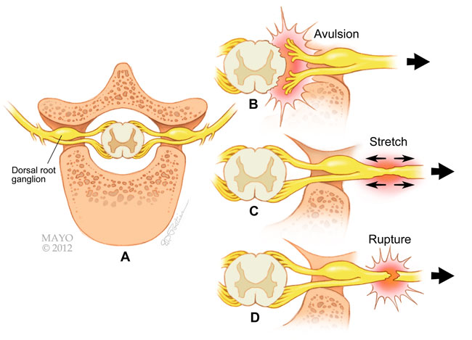
Brachial Plexus Injuries

Slide 19
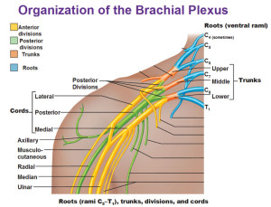
Erb’s Paralysis
Site of injury: upper trunk ; Erb’s Point
6 nerves meet
C5 Root
C6 Root
Suprascapular nerve
Nerve to subclavius
dorsal division
ventral division

Slide 20
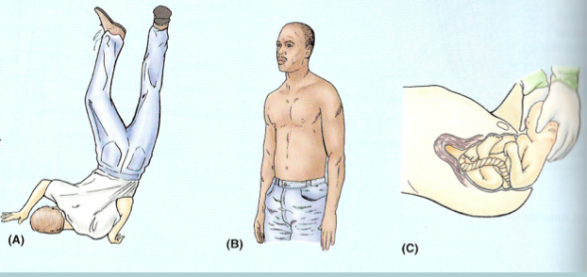
Erb’s Paralysis: The Cause
Undue separation of head and shoulder
Birth injury Fall on shoulder During anesthesia
Roots involved: C5, C6
Muscle paralysed: Biceps, deltoid, brachialis and brachioradialis, supraspinatus, infraspinatus and supinator

Slide 21
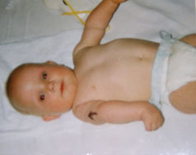
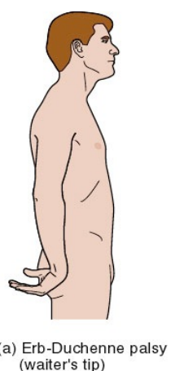
Erb’s Paralysis: Deformity- position of limb policeman’s tip or porter’s tip hand
Arms: hangs by the side, adducted and medially rotated
Forearm: extended and pronated
Disability: abduction and lateral rotation of arm shoulder
Flexion and supination of forearm
Loss of biceps and supinator jerks
Loss of sensations over the lower part of deltoid

Slide 22
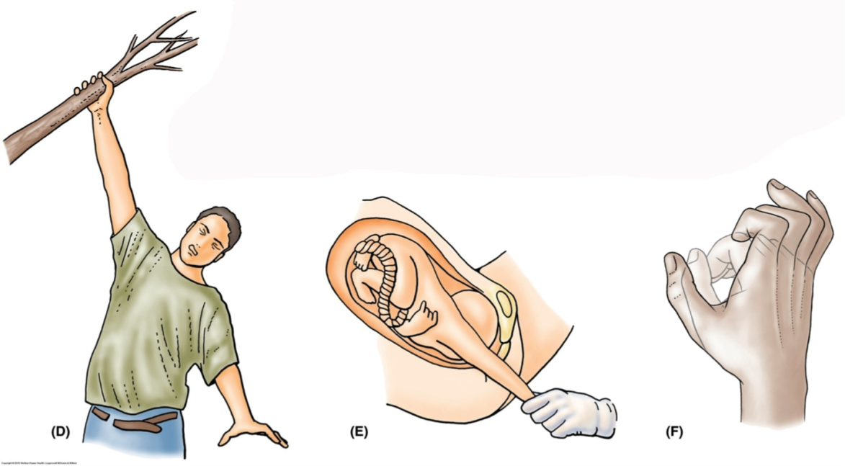
Klumpke’s paralysis
Site of injury: lower trunk of brachial plexus
Cause of injury: undue abduction of arm as in clutching something after a fall from a height or birth injury
Nerve roots involved: T1 and partly C8
Muscle Paralysed: intrinsic muscles of hand
Ulnar flexors of wrist and fingers

Slide 23
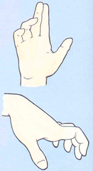
Klumpke’s paralysis
Disability: ( Motor loss) paralysis of ulnar flexors of fingers
loss of sensations :along ulnar border of forearm and hand
Horner’s Syndrome: Ptosis, miosis, anhydrosis, enophthalmos and loss of ciliospinal reflex due to injury to sympathetic fibres to head and neck in T1
Deformity: Claw hand
hyperextension at metacarpo-phlangeal joints
flexion at inter - phalangeal joints

Slide 24
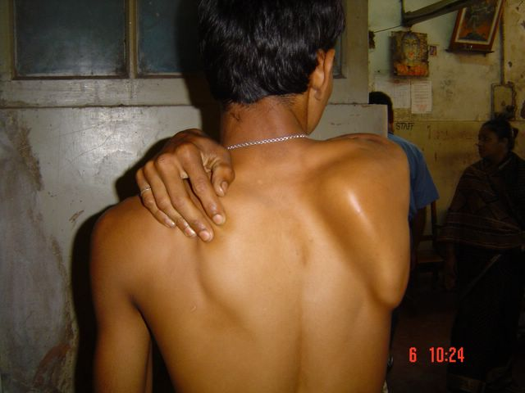
Injury to nerve to Serratus Anterior Nerve of Bell
Cause: sudden pressure on shoulder from above
carrying heavy load on shoulders
Deformity: winging of scapula
Disability: loss of pushing and punching
loss of overhead abduction at shoulder

Slide 26
1.
Which of the following spinal nerves contribute innervation to upper limb?
A. C4,5,6,7,8 & T1,2
B. C4,5,6,7,8 & T1
C. C5,6,7,8 & T1,2
D. C5,6,7,8 & T1

Slide 27
2.
Which part of a spinal nerve form root of brachial plexus?
A. Dorsal root
B. Ventral root
C. Anterior primary ramus
D. Posterior primary ramus

Slide 28
3.
Which of the following structure of upper limb is not supplied by sympathetic fibres?
A. skeletal muscles
B. arteries
C. sweat glands
D. arrector pilorum muscle

Slide 29
4.
Ist part of axillary artery is related medially to
A. medial cord of brachial plexus
B. axillary vein
C. ulnar nerve
D. cephalic vein

Slide 30
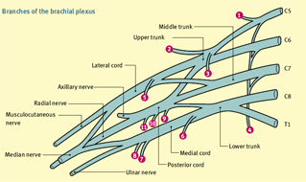
5. Identify

